Slide 1


The Supernova Origins of Stardust Enriched with ¹³C and ¹⁵N
Jack Schulte^{1,2∞}
Maitrayee Bose^{1∞}, Patrick Young¹, and Gregory Vance¹
¹School of Earth and Space Exploration, ²Department of Physics
∞ Center for Isotope Analysis (CIA)

Slide 2
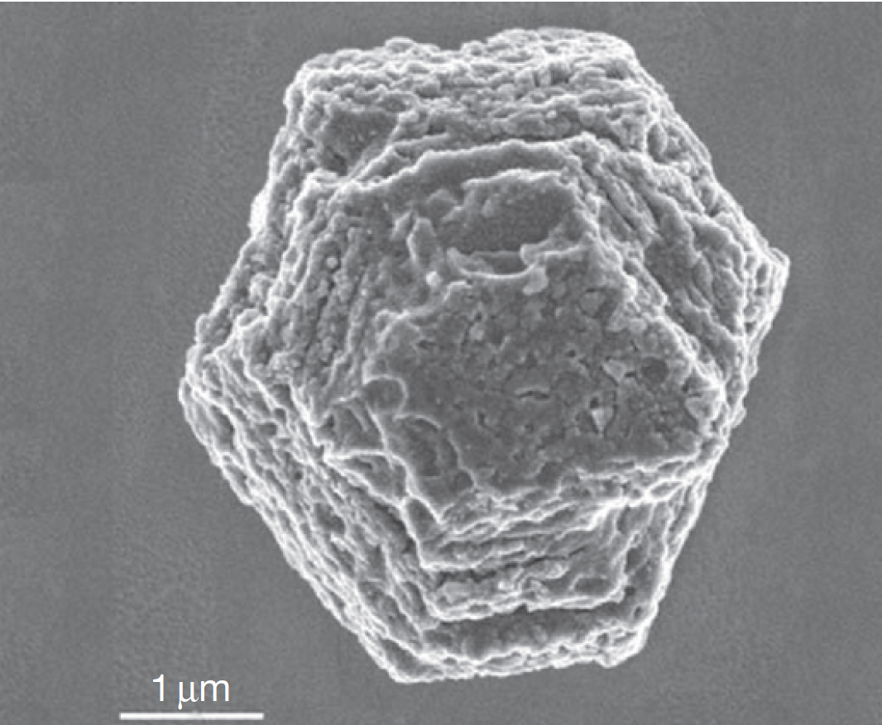
What is stardust?
Introduction
Methods
Results: Carbon and Nitrogen
Conclusions
Results: Aluminum
Results: Temperature & Density History
Stardust (presolar grains) are very small (nanometers to microns) dust particles in unaltered meteorites
Grains are > 3.9 million years older than the birth of the solar system (Heck et al. 2020)
Condensed out of outflow from supernovae (SNe), asymptotic giant branch (AGB) stars, classical novae, and J-type carbon stars
SEM Image of Presolar SiC
Credit: Zinner 2014
Notes:
SiC grains analyzed in Heck paper are aged between 3.9 million years and 3 billion years before the solar system was born

Slide 3
Models and Methods
Introduction
Methods
Results: Carbon and Nitrogen
Conclusions
Results: Aluminum
Results: Temperature & Density History
Two 3D SN models and two 1D SN models used
Both 3D models created by ASU’s Patrick Young
Plots were made using MATLAB and the smoothed particle hydrodynamics file-viewer SPLASH
 | 15S | 15A | 1D15C | 1D15Y
Model Names | 50Am | jet3b | S15 (comp.) | S15 (yield)
Dimensions | 3 | 3 | 1 | 1
Symmetry | Spherically symm. | velocity asymm. 2:1 | Spherically symm. | Spherically symm.
Simulated Time after Core Bounce | 43 hours | 43 hours | 7 hours | 7 hours

Slide 4
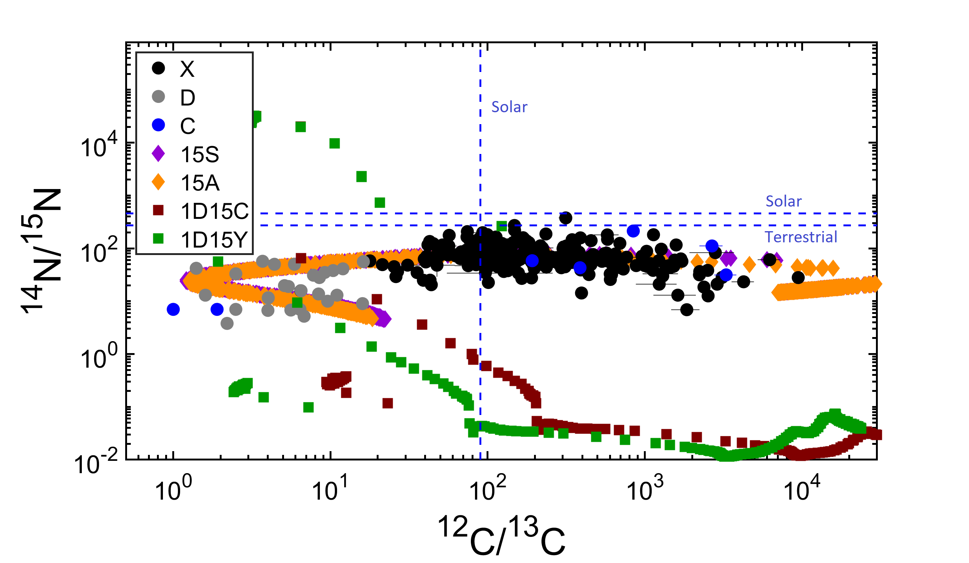
Results: Carbon and Nitrogen
Introduction
Methods
Results: Carbon and Nitrogen
Conclusions
Results: Aluminum
Results: Temperature & Density History
SN ejecta with ¹²C/¹³C < 20 and ¹⁴N/¹⁵N < 100 from the interior of the explosion is comparable to presolar SiC C & D grains.
Notes:
CNO cycle

Slide 5
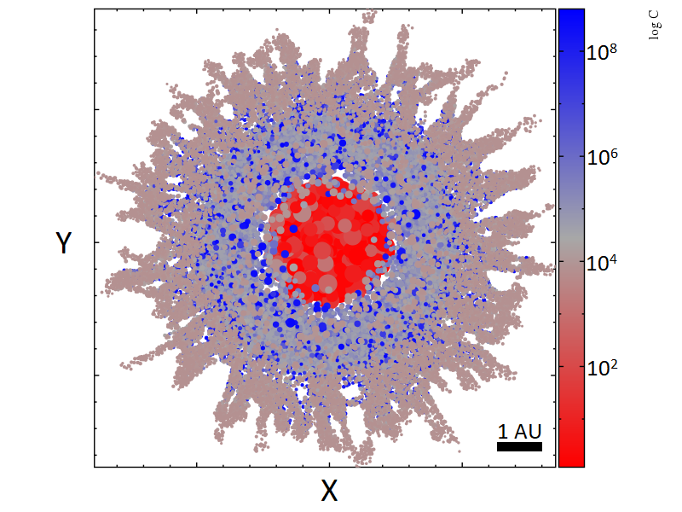
Results: Carbon and Nitrogen
Introduction
Methods
Results: Carbon and Nitrogen
Conclusions
Results: Aluminum
Results: Temperature & Density History
15S
¹³C enrichments (low ¹²C/¹³C) are only possible in the interior of the explosion.
Material in the exterior is more similar to SiC X grains.
¹²C(p,γ)¹³N(β+)¹³C
1 AU

Slide 6
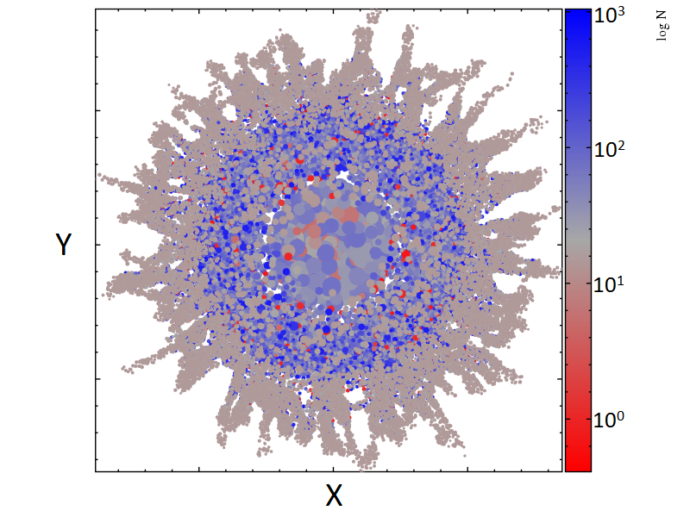
Results: Carbon and Nitrogen
Introduction
Methods
Results: Carbon and Nitrogen
Conclusions
Results: Aluminum
Results: Temperature & Density History
15S
This same interior material has ¹⁴N/¹⁵N < 100 which is consistent with SiC C and D grains.
¹⁴N(α,γ)¹⁸F(p,α)¹⁵O(β+)¹⁵N
1 AU

Slide 7
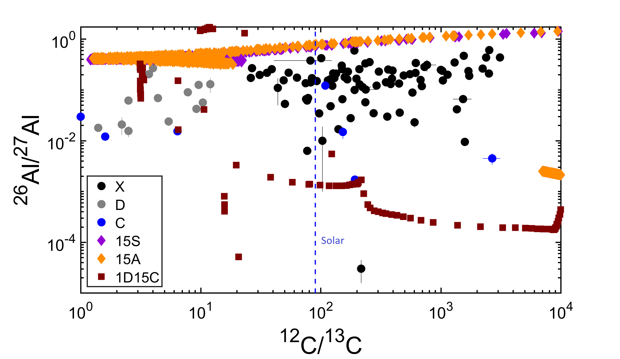
Results: Aluminum
Introduction
Methods
Results: Carbon and Nitrogen
Conclusions
Results: Aluminum
Results: Temperature & Density History
3D models predict higher ²⁶Al abundances than 1D models which meets expectations for SN ejecta.
Notes:
26Al also the result of proton capture

Slide 8
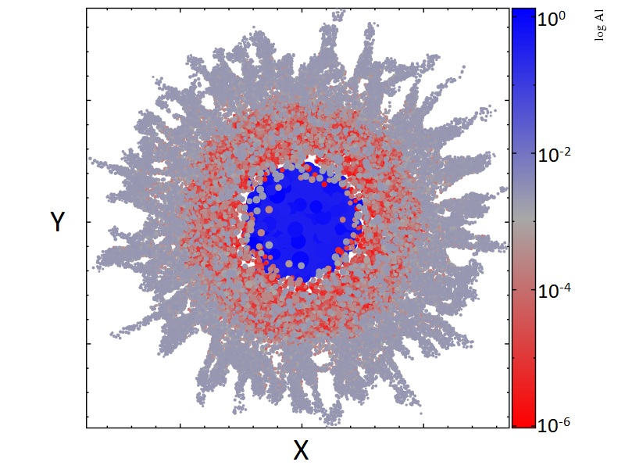
Results: Aluminum
Introduction
Methods
Results: Carbon and Nitrogen
Conclusions
Results: Aluminum
Results: Temperature & Density History
15S
Very large ²⁶Al abundances are achieved in the same region, also consistent with presolar grain data.
²⁵Mg(p,γ)²⁶Al
1 AU

Slide 9
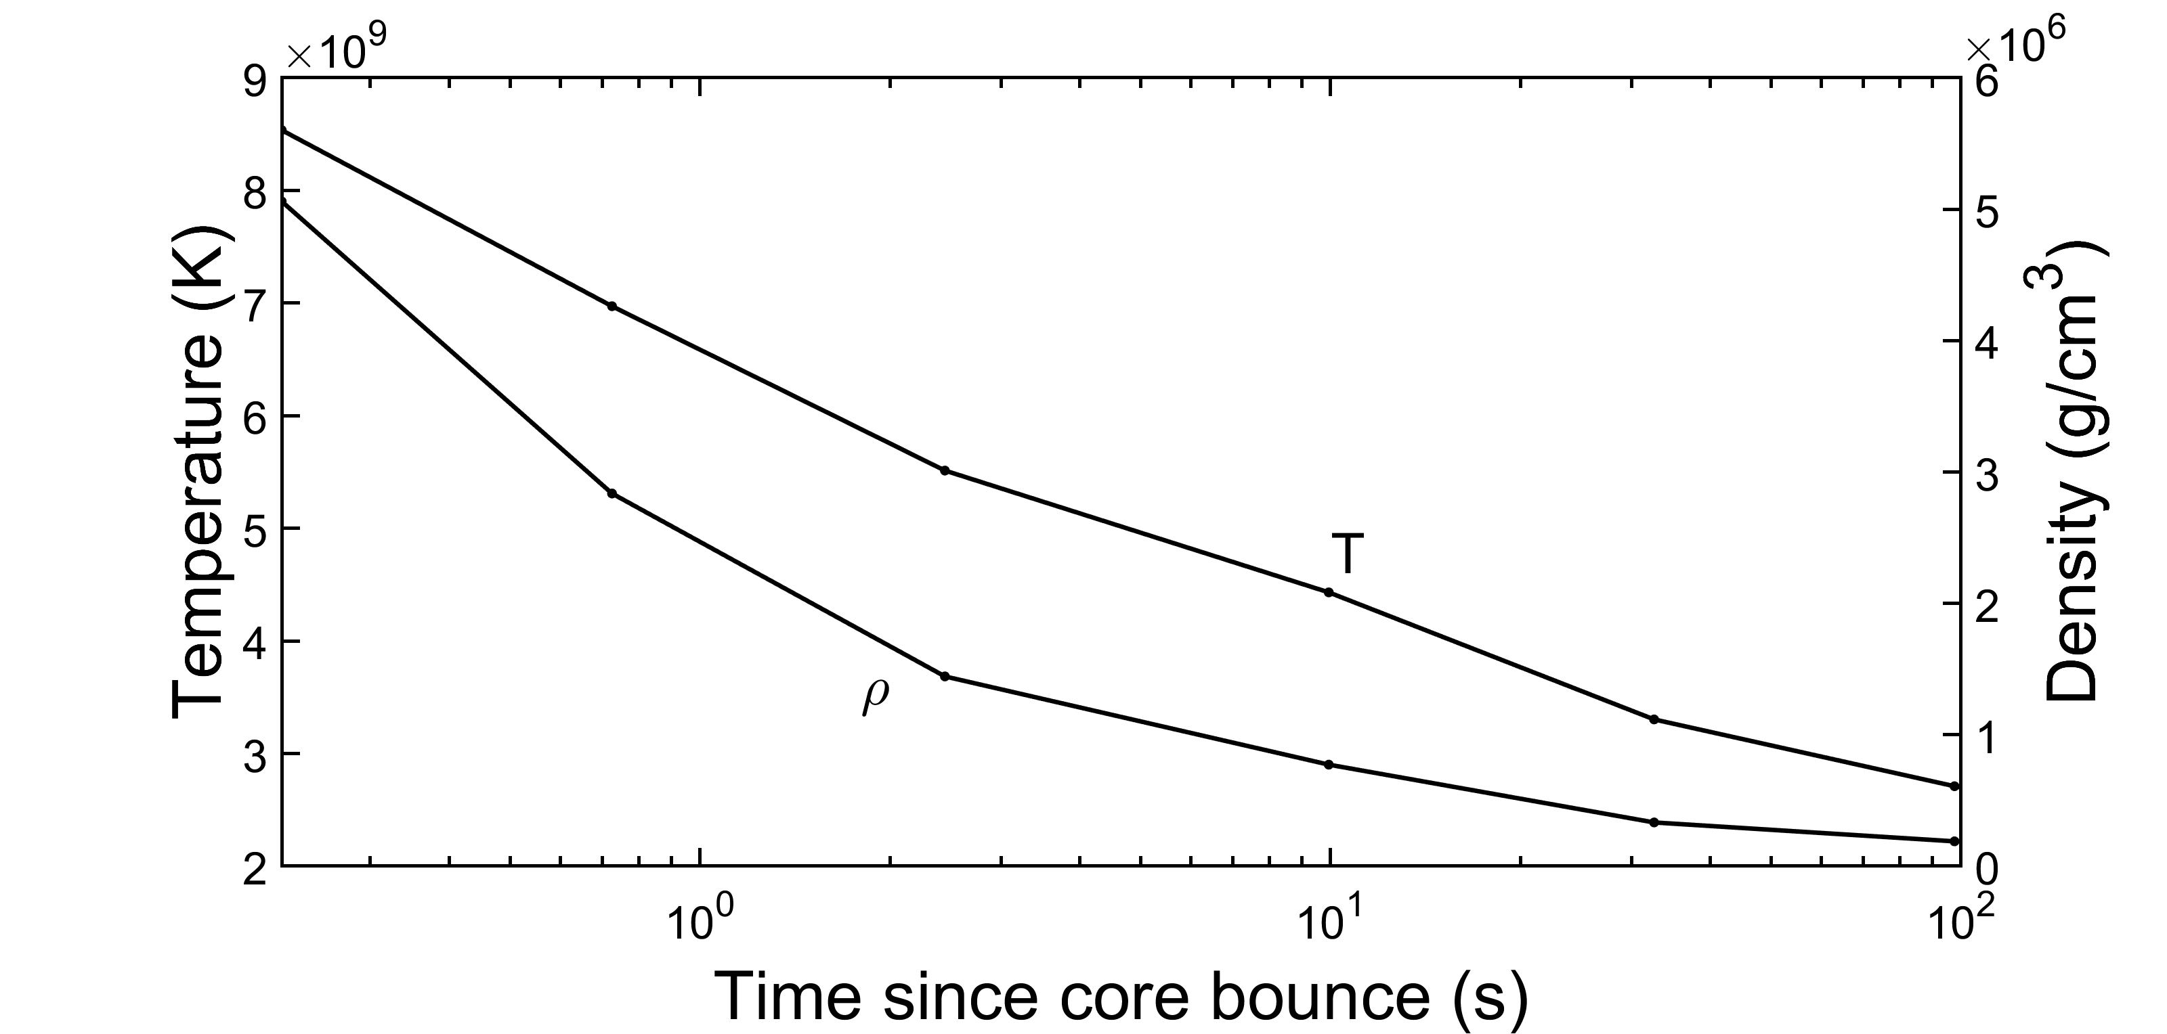
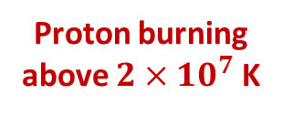
Results: Temperature & Density History
Introduction
Methods
Results: Carbon and Nitrogen
Conclusions
Results: Aluminum
Results: Temperature & Density History
15S
Material close to the center reaches proton burning conditions immediately after the shock propagates through it.
Proton burning above $2×{10}^{7}$ K

Slide 10
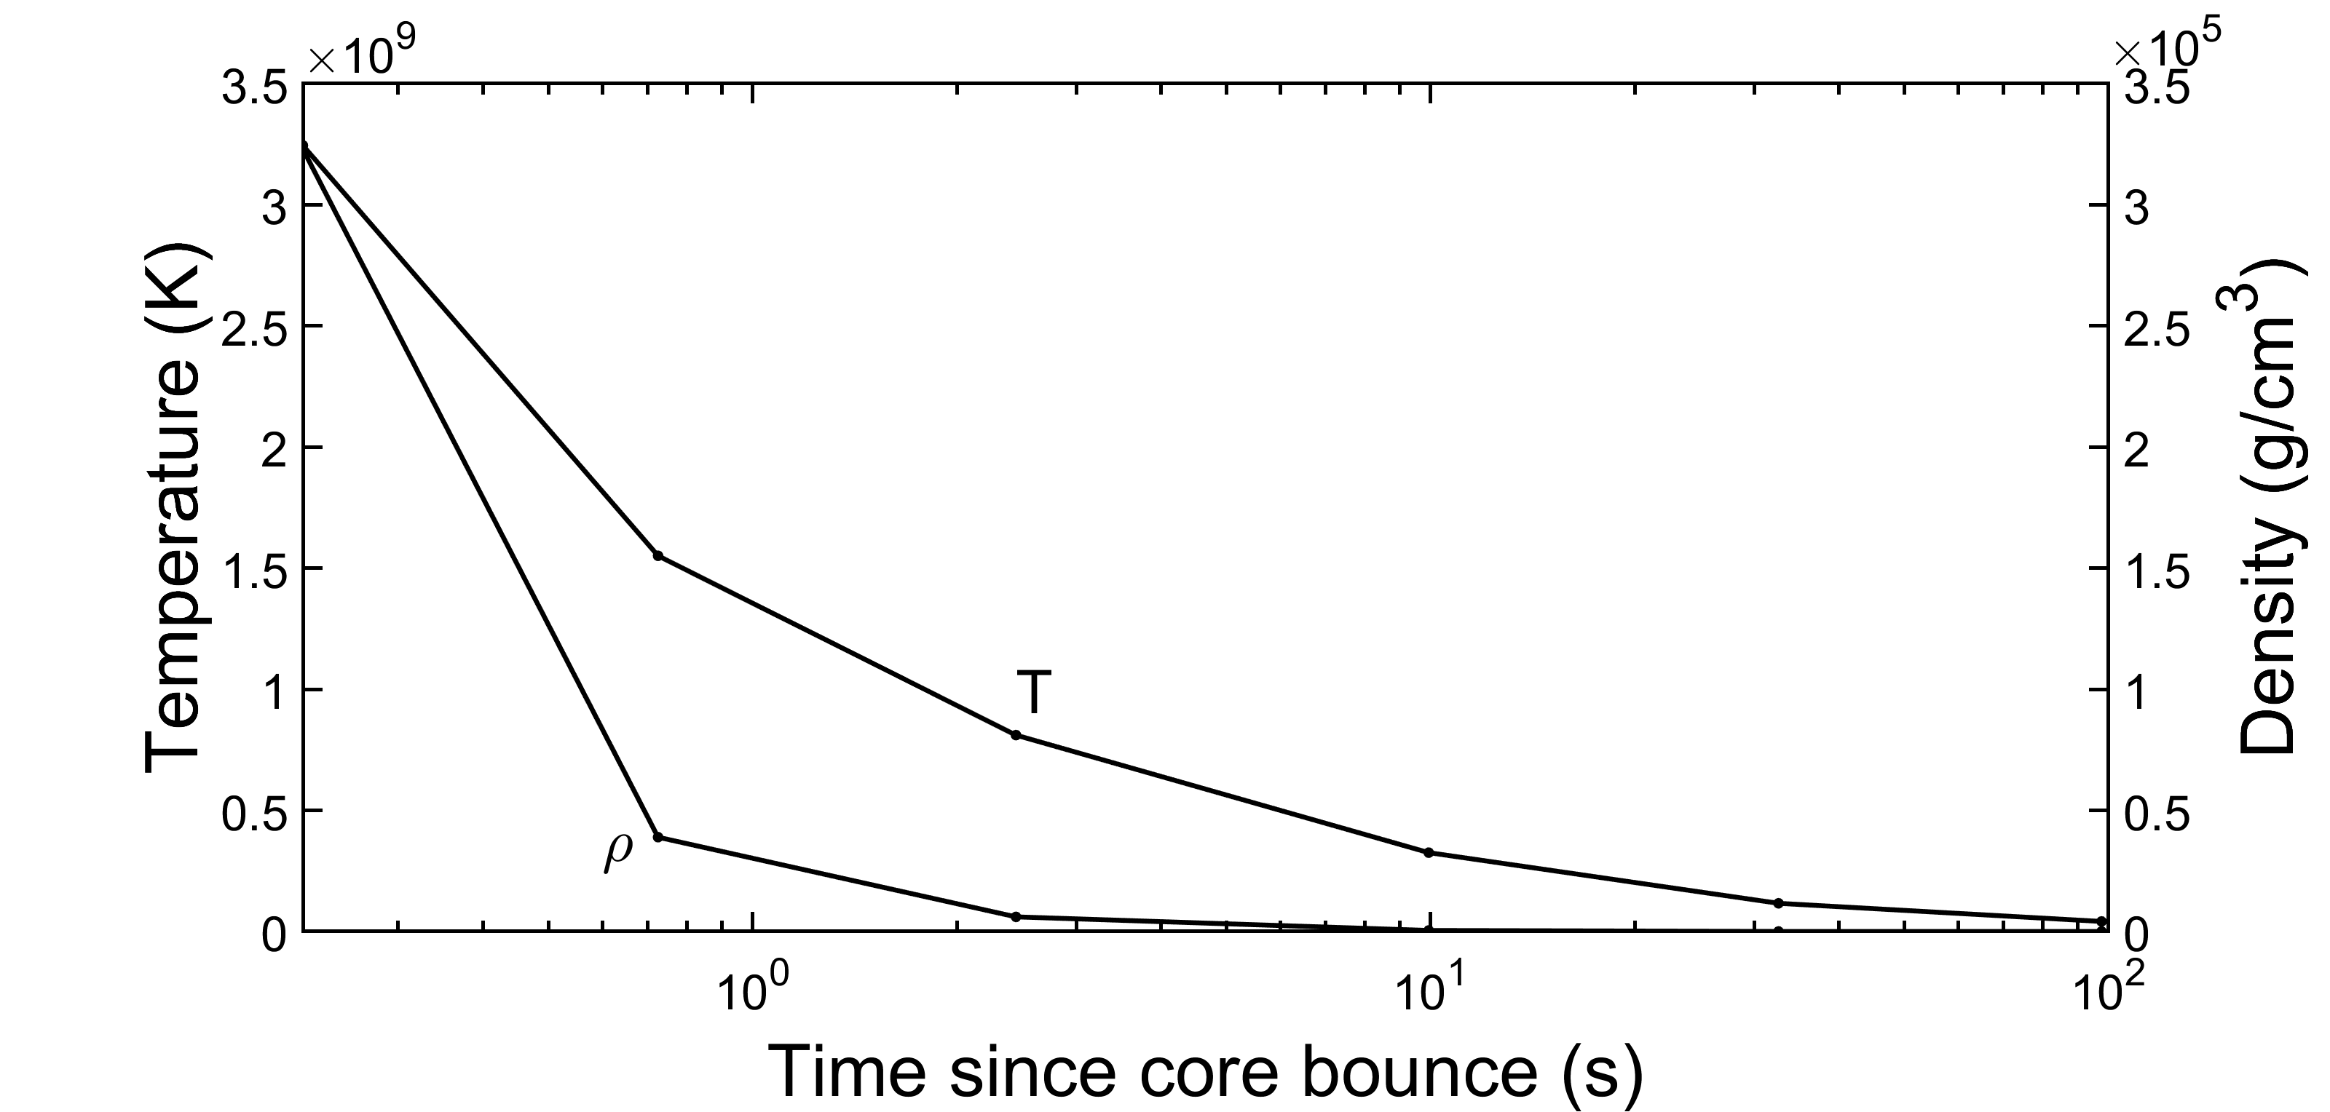
Results: Temperature & Density History
Introduction
Methods
Results: Carbon and Nitrogen
Conclusions
Results: Aluminum
Results: Temperature & Density History
15A
The CNO cycle leads to an increase in the production of the isotopes ¹³C and ¹⁵N.
Proton burning above $2×{10}^{7}$ K

Slide 11
Conclusions
Introduction
Methods
Results: Carbon and Nitrogen
Conclusions
Results: Aluminum
Results: Temperature & Density History
Possible for SiC C and D grains to condense in the interior of a SN explosion
¹³C, ¹⁵N, and ²⁶Al enrichments are the result of high temperatures enabling proton burning
Enrichments happen after the star’s core collapses, during the “explosion”
Acknowledgements: ASU/NASA Space Grant

